Slide 1
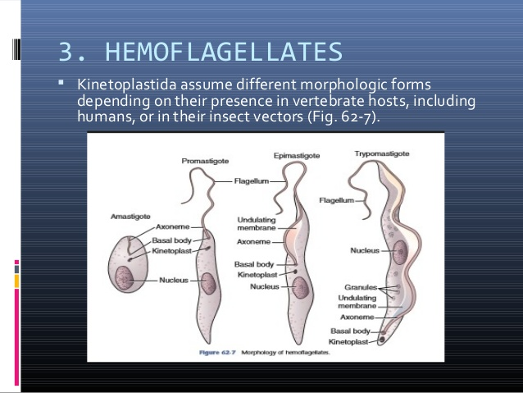
Microbiology Dep.
Second year
Parasitology
4th Lec.
Lecturer: Assist prof.
Dr. Sally Ahmed
Hemoflagellates
(Parasitic Leishmania of human beings)
The family Trypanosomatidae, which imcludes the hemoflagellates, contains a number of genera, only two of which parasitize humans, which are Trypanosoma and Leishmania. Life cycles of these two genera are including two hosts, vertebrate host including humans and invertebrate host, usually blood mailing insects. During life cycle, there are four forms of life that either found in vertebrate host (as intracellular parasites) or in the insects (as extracelluler parasites).
Morphology of haemoflagellate

Slide 2
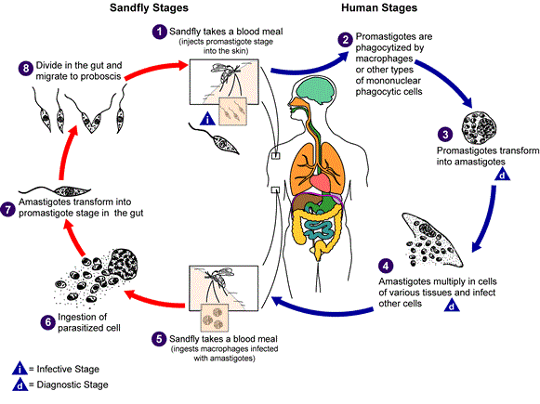
Genus Leishmania:
1-L. tropica, the etiologic agent of cutaneous leishmaniasis, or oriental sore.
2-L. donovani causes visceral leishmaniasis or kala-azar.
3-L. braziliensis causes mucocutanous leishmaniasis.
Life cycle:

